Slide 1
Pauline Narvas
Technical sales support advisor, Bio-techne

Slide 2
Who are Bio-Techne?
They are a leading global life sciences company
Formerly known as Techne Corporations.
Provide tools and resources for the scientific community.

Slide 3
Role of a Technical Sales Support Advisor
Technical Support
Provide first-line technical sales support inbound for customer queries specifically the EMEA territories, through the telephone, live-chat and email.
Sales Aspects
Assist the sales team to ensure an increase in revenue
Deal with complaints and feedbacks responsibly
Advising customers on the best product for their research
Marketing Aspects
Creation of e-catalogues of the company’s products
Compile literature, research from customers for marketing purposes

Slide 4
Requirements
Essential
Bsc or equivalent in a Life Sciences subject
Experience in a customer/sales focused environment
Excellent IT skills
Attributes & Qualities
Passion for customer service
Self-motivated
Time-management, organizational, multi-tasking skills
Written and verbal communication skills
Listening skills and rapport-building skills
Team work

Slide 5
What makes me suited for this role?

Slide 6
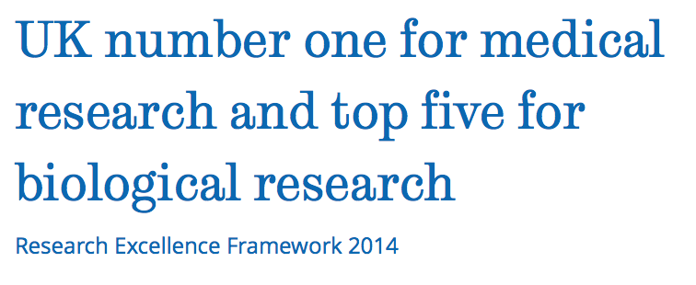
Education
Biomedical Sciences (BSc)

Slide 7
Work Experiences
Experiences in Retail, Sales and Hospitality.

Slide 8
Other unique selling points
IT Skills

Slide 9
summary

Slide 10
Thank you for listening !
Any questions?

